Slide 1
Welcome to our webinar!
This webinar starts in 5 minutes - please stay tuned
This webinar will be recorded
You will get the slides, recording and SQL snippets
During the webinar, you may ask questions using the Q&A button - you may ask questions anonymously
You can hop on and off on all the sessions
Day 2 | 15:00 - 16:00 Implementing DV Best Practices 16:00 - 16:15 Break 16:15 - 17:15 Working with metadata 17:15 - 17:30 Break 17:30 - 18:30 SQL for preparing report data

Slide 2
DATA VIRTUALITY
Topic: SQL for preparing report data

Slide 3
Agenda
SQL window functions concepts
List of window functions
SQL Window functions: putting it all together
Pivoting data
Unpivot data
Code
All the code used in the presentation is available in Data Virtuality’s GitHub account.

Slide 4
YTD, rolling avg, period over period
SELECT * FROM "master_class_2021_reporting.Window06";;
yr | mnth | val | ytd | sum_rolling_12_months | avg_rolling_12_months | avg_rolling_3_months | lag_12_months_ago | lag_3_months_ago | YoY | MoM | first_rolling_12_months | first_rolling_3_months | slope_rolling_12_mo | slope_rolling_3_mo
2019 | 1 | 3 | 3 | 3 | 3 | 3 |  |  |  |  | 3 | 3 | - | -
2019 | 2 | 4 | 7 | 7 | 3.5 | 3.5 |  |  |  | 33.33333 | 3 | 3 | 0.0833 | 0.3333
2019 | 3 | 5 | 12 | 12 | 4 | 4 |  |  |  | 25 | 3 | 3 | 0.1667 | 0.6667
2019 | 4 | 6 | 18 | 18 | 4.5 | 5 |  | 3 |  | 20 | 3 | 3 | 0.2500 | 1.0000
2019 | 5 | 7 | 25 | 25 | 5 | 6 |  | 4 |  | 16.66667 | 3 | 4 | 0.3333 | 1.0000
2019 | 6 | 8 | 33 | 33 | 5.5 | 7 |  | 5 |  | 14.28571 | 3 | 5 | 0.4167 | 1.0000
2019 | 7 | 9 | 42 | 42 | 6 | 8 |  | 6 |  | 12.5 | 3 | 6 | 0.5000 | 1.0000
2019 | 8 | 10 | 52 | 52 | 6.5 | 9 |  | 7 |  | 11.11111 | 3 | 7 | 0.5833 | 1.0000
2019 | 9 | 11 | 63 | 63 | 7 | 10 |  | 8 |  | 10 | 3 | 8 | 0.6667 | 1.0000
2019 | 10 | 12 | 75 | 75 | 7.5 | 11 |  | 9 |  | 9.090909 | 3 | 9 | 0.7500 | 1.0000
2019 | 11 | 13 | 88 | 88 | 8 | 12 |  | 10 |  | 8.333333 | 3 | 10 | 0.8333 | 1.0000
2019 | 12 | 14 | 102 | 102 | 8.5 | 13 |  | 11 |  | 7.692308 | 3 | 11 | 0.9167 | 1.0000
2020 | 1 | 44 | 44 | 143 | 11.91667 | 23.66667 | 3 | 12 | 1366.667 | 214.2857 | 3 | 12 | 3.4167 | 10.6667
2020 | 2 | 45 | 89 | 184 | 15.33333 | 34.33333 | 4 | 13 | 1025 | 2.272727 | 4 | 13 | 3.4167 | 10.6667
2020 | 3 | 46 | 135 | 225 | 18.75 | 45 | 5 | 14 | 820 | 2.222222 | 5 | 14 | 3.4167 | 10.6667
2020 | 4 | 47 | 182 | 266 | 22.16667 | 46 | 6 | 44 | 683.3333 | 2.173913 | 6 | 44 | 3.4167 | 1.0000
2020 | 5 | 48 | 230 | 307 | 25.58333 | 47 | 7 | 45 | 585.7143 | 2.12766 | 7 | 45 | 3.4167 | 1.0000
2020 | 6 | 49 | 279 | 348 | 29 | 48 | 8 | 46 | 512.5 | 2.083333 | 8 | 46 | 3.4167 | 1.0000
2020 | 7 | 50 | 329 | 389 | 32.41667 | 49 | 9 | 47 | 455.5556 | 2.040816 | 9 | 47 | 3.4167 | 1.0000
2020 | 8 | 51 | 380 | 430 | 35.83333 | 50 | 10 | 48 | 410 | 2 | 10 | 48 | 3.4167 | 1.0000
2020 | 9 | 52 | 432 | 471 | 39.25 | 51 | 11 | 49 | 372.7273 | 1.960784 | 11 | 49 | 3.4167 | 1.0000
2020 | 10 | 53 | 485 | 512 | 42.66667 | 52 | 12 | 50 | 341.6667 | 1.923077 | 12 | 50 | 3.4167 | 1.0000
2020 | 11 | 54 | 539 | 553 | 46.08333 | 53 | 13 | 51 | 315.3846 | 1.886792 | 13 | 51 | 3.4167 | 1.0000
2020 | 12 | 55 | 594 | 594 | 49.5 | 54 | 14 | 52 | 292.8571 | 1.851852 | 14 | 52 | 3.4167 | 1.0000
2021 | 1 | 200 | 200 | 750 | 62.5 | 103 | 44 | 53 | 354.5455 | 263.6364 | 44 | 53 | 13.0000 | 49.0000
2021 | 2 | 201 | 401 | 906 | 75.5 | 152 | 45 | 54 | 346.6667 | 0.5 | 45 | 54 | 13.0000 | 49.0000
2021 | 3 | 202 | 603 | 1062 | 88.5 | 201 | 46 | 55 | 339.1304 | 0.497512 | 46 | 55 | 13.0000 | 49.0000
2021 | 4 | 203 | 806 | 1218 | 101.5 | 202 | 47 | 200 | 331.9149 | 0.49505 | 47 | 200 | 13.0000 | 1.0000
2021 | 5 | 204 | 1010 | 1374 | 114.5 | 203 | 48 | 201 | 325 | 0.492611 | 48 | 201 | 13.0000 | 1.0000
2021 | 6 | 205 | 1215 | 1530 | 127.5 | 204 | 49 | 202 | 318.3673 | 0.490196 | 49 | 202 | 13.0000 | 1.0000
2021 | 7 | 206 | 1421 | 1686 | 140.5 | 205 | 50 | 203 | 312 | 0.487805 | 50 | 203 | 13.0000 | 1.0000
2021 | 8 | 207 | 1628 | 1842 | 153.5 | 206 | 51 | 204 | 305.8824 | 0.485437 | 51 | 204 | 13.0000 | 1.0000
2021 | 9 | 208 | 1836 | 1998 | 166.5 | 207 | 52 | 205 | 300 | 0.483092 | 52 | 205 | 13.0000 | 1.0000
2021 | 10 | 209 | 2045 | 2154 | 179.5 | 208 | 53 | 206 | 294.3396 | 0.480769 | 53 | 206 | 13.0000 | 1.0000
2021 | 11 | 210 | 2255 | 2310 | 192.5 | 209 | 54 | 207 | 288.8889 | 0.478469 | 54 | 207 | 13.0000 | 1.0000
2021 | 12 | 211 | 2466 | 2466 | 205.5 | 210 | 55 | 208 | 283.6364 | 0.47619 | 55 | 208 | 13.0000 | 1.0000

Slide 5
Window functions

Slide 6
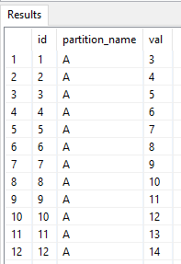
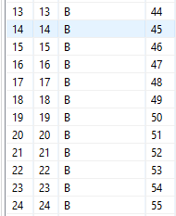
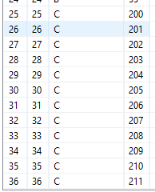
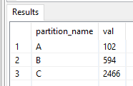
Grouping in SQL
SELECT "id", "partition_name", "val" FROM "master_class_2021_reporting.Partition_Data";;
create view master_class_2021_reporting.Window01 as
SELECT
"partition_name",
sum("val") as val
FROM
"master_class_2021_reporting.Partition_Data"
group by
"partition_name"
;;

Slide 7
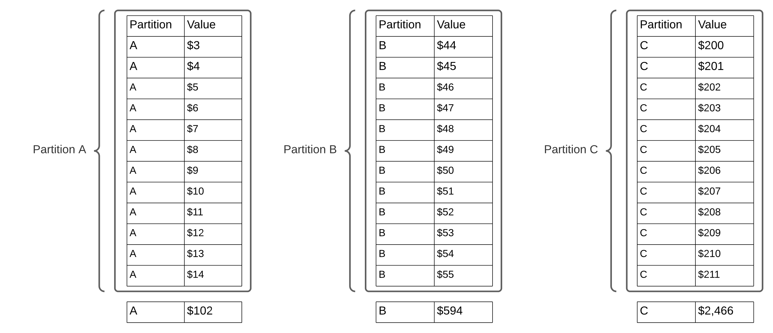
Grouping in SQL

Slide 8
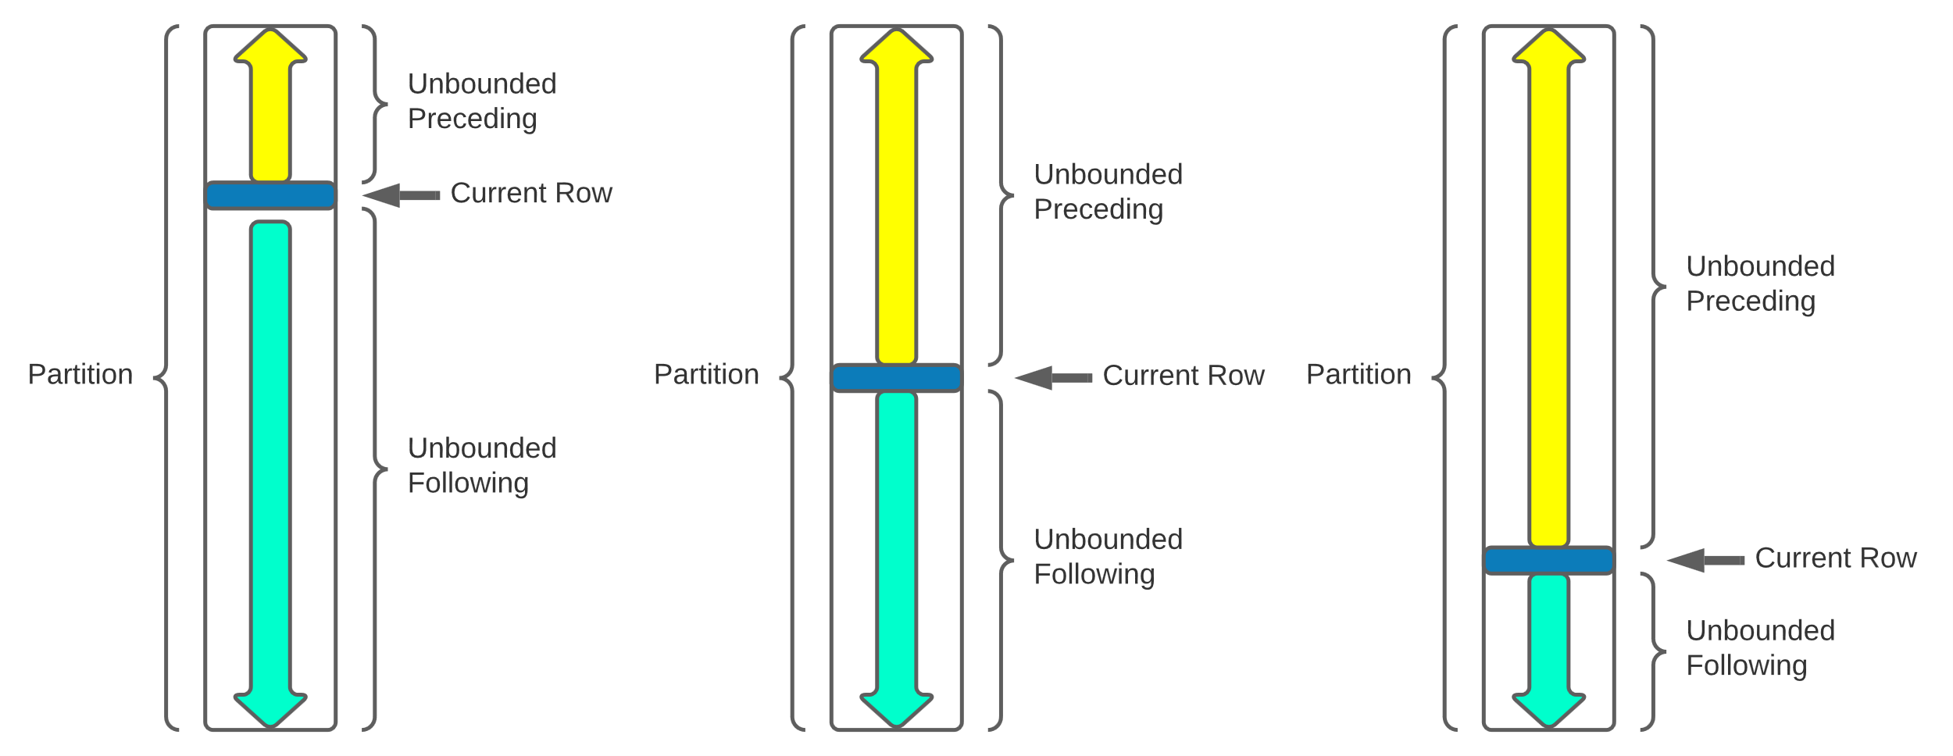
Window functions: unbounded
Applications for temporal data: cumulative sum, YTD, payment plans aka loans, sales revenue vs target, runways, etc.

Slide 9
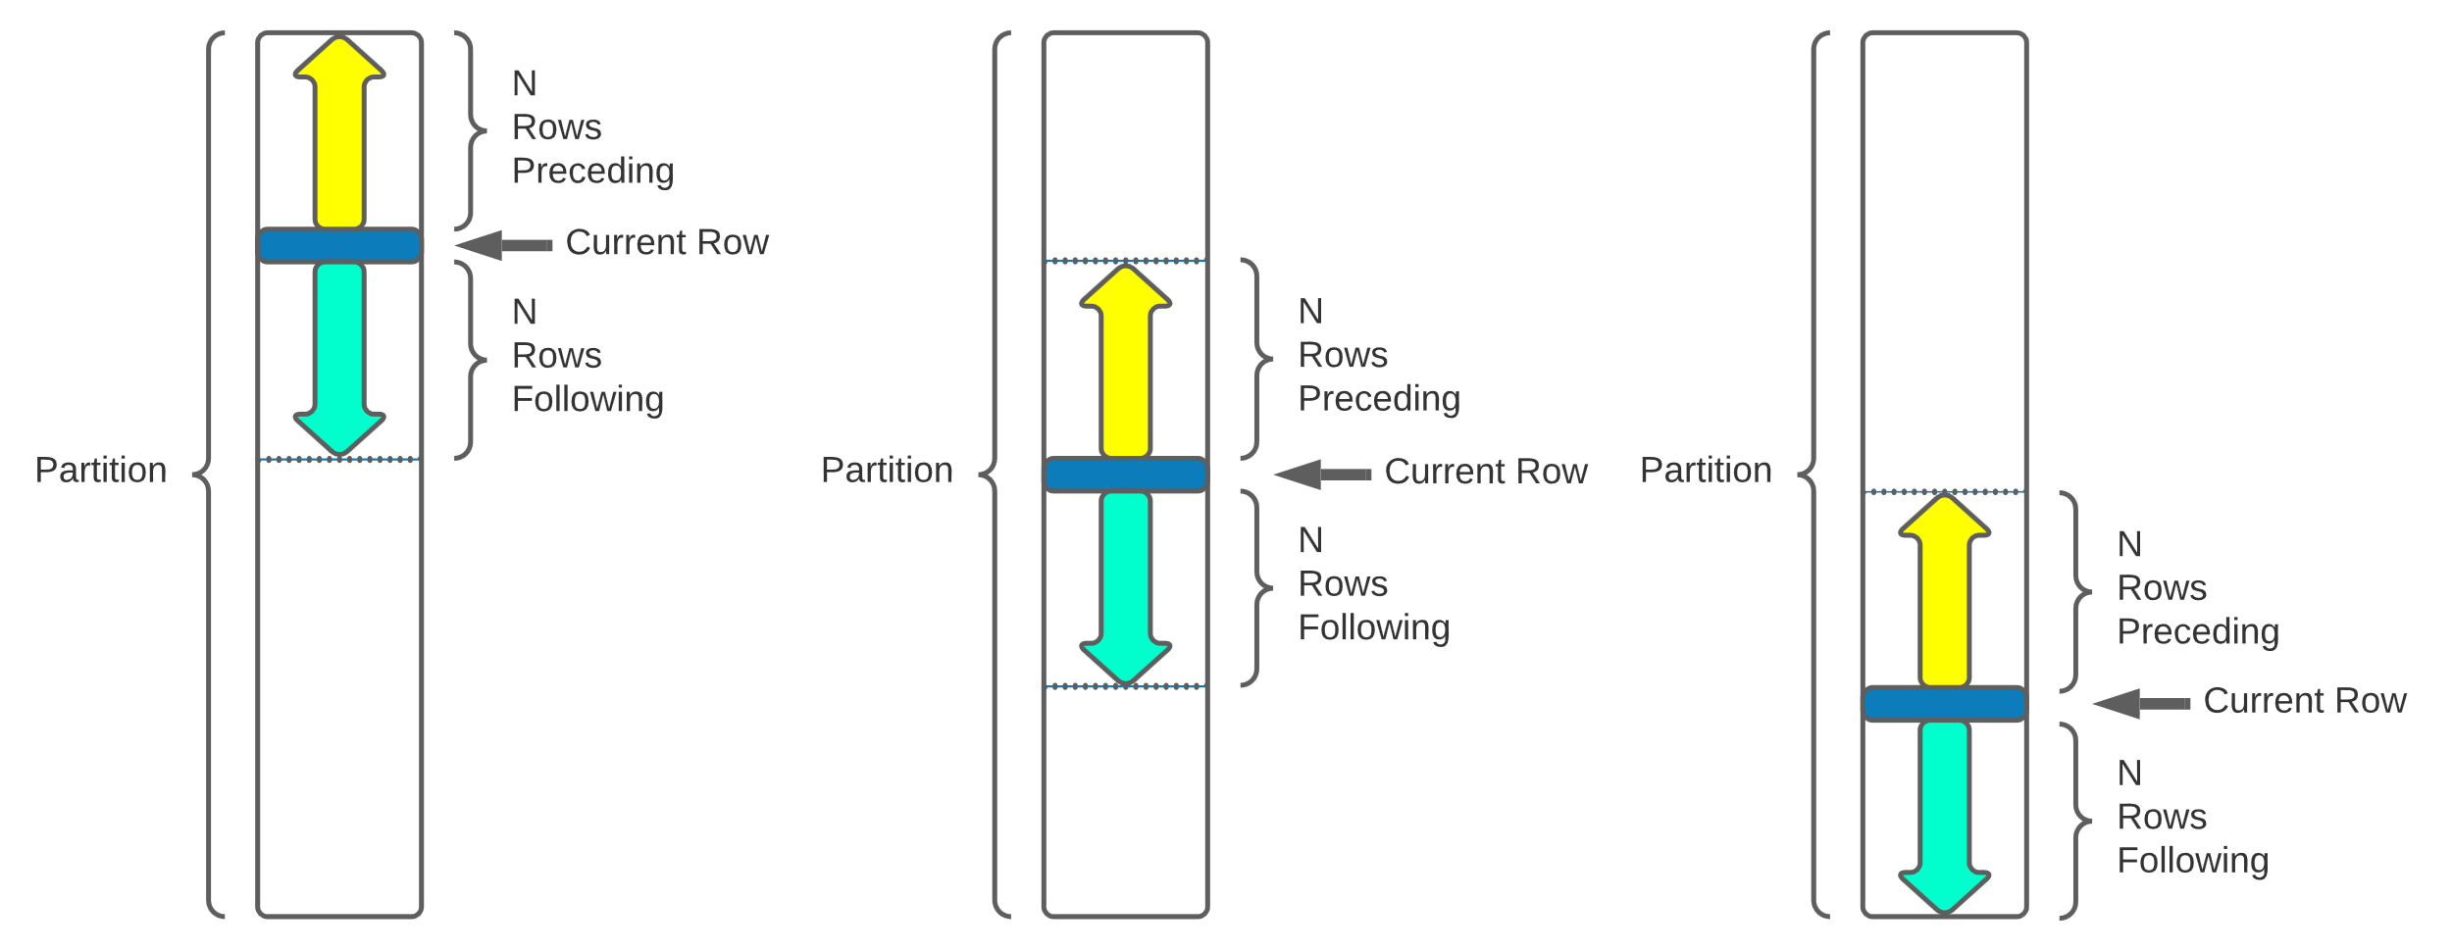
Window functions: bounded
Applications for temporal data: trailing 12 months, recent trends, etc.

Slide 10
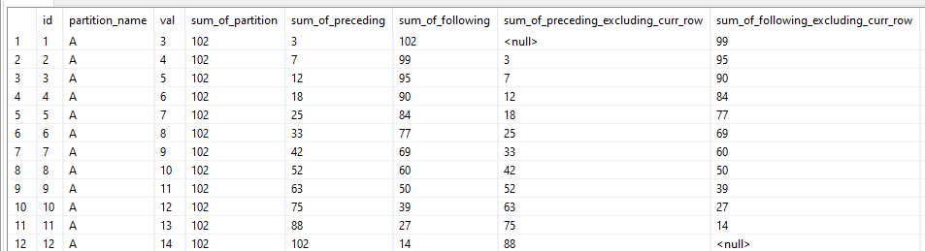
Window functions: unbounded example
create view master_class_2021_reporting.Window02 as
SELECT
Id,
"partition_name",
"val",
sum("val") over(partition by "partition_name") as sum_of_partition,
-- equivalent to next line
--sum("val") over(partition by "partition_name" order by id rows unbounded preceding) as sum_of_preceding,
sum("val") over(partition by "partition_name" order by id rows between unbounded preceding and current row) as sum_of_preceding,
sum("val") over(partition by "partition_name" order by id rows between current row and unbounded following) as sum_of_following,
sum("val") over(partition by "partition_name" order by id rows between unbounded preceding and 1 preceding) as sum_of_preceding_excluding_curr_row,
sum("val") over(partition by "partition_name" order by id rows between 1 following and unbounded following) as sum_of_following_excluding_curr_row
FROM
"master_class_2021_reporting.Partition_Data"
order by id
;;

Slide 11
Window functions: unbounded example
create view master_class_2021_reporting.Window02 as
SELECT
Id,
"partition_name",
"val",
sum("val") over(partition by "partition_name") as sum_of_partition,
-- equivalent to next line
--sum("val") over(partition by "partition_name" order by id rows unbounded preceding) as sum_of_preceding,
sum("val") over(partition by "partition_name" order by id rows between unbounded preceding and current row) as sum_of_preceding,
sum("val") over(partition by "partition_name" order by id rows between current row and unbounded following) as sum_of_following,
sum("val") over(partition by "partition_name" order by id rows between unbounded preceding and 1 preceding) as sum_of_preceding_excluding_curr_row,
sum("val") over(partition by "partition_name" order by id rows between 1 following and unbounded following) as sum_of_following_excluding_curr_row
FROM
"master_class_2021_reporting.Partition_Data"
order by id
;;

Slide 12
Window functions: bounded example
create view master_class_2021_reporting.Window02 as
SELECT
Id,
"partition_name",
"val",
sum("val") over(partition by "partition_name") as sum_of_partition,
-- equivalent to next line
--sum("val") over(partition by "partition_name" order by id rows unbounded preceding) as sum_of_preceding,
sum("val") over(partition by "partition_name" order by id rows between unbounded preceding and current row) as sum_of_preceding,
sum("val") over(partition by "partition_name" order by id rows between current row and unbounded following) as sum_of_following,
sum("val") over(partition by "partition_name" order by id rows between unbounded preceding and 1 preceding) as sum_of_preceding_excluding_curr_row,
sum("val") over(partition by "partition_name" order by id rows between 1 following and unbounded following) as sum_of_following_excluding_curr_row
FROM
"master_class_2021_reporting.Partition_Data"
order by id
;;

Slide 13
Window functions: bounded example
create view master_class_2021_reporting.Window02 as
SELECT
Id,
"partition_name",
"val",
sum("val") over(partition by "partition_name") as sum_of_partition,
-- equivalent to next line
--sum("val") over(partition by "partition_name" order by id rows unbounded preceding) as sum_of_preceding,
sum("val") over(partition by "partition_name" order by id rows between unbounded preceding and current row) as sum_of_preceding,
sum("val") over(partition by "partition_name" order by id rows between current row and unbounded following) as sum_of_following,
sum("val") over(partition by "partition_name" order by id rows between unbounded preceding and 1 preceding) as sum_of_preceding_excluding_curr_row,
sum("val") over(partition by "partition_name" order by id rows between 1 following and unbounded following) as sum_of_following_excluding_curr_row
FROM
"master_class_2021_reporting.Partition_Data"
order by id
;;

Slide 14
List of window functions

Slide 15
Window functions: list
https://documentation.datavirtuality.com/24/reference-guide/sql-support/expressions#Expressions-window_functions
ROW_NUMBER() – functional the same as COUNT(*) with the same window specification. Assigns a number to each row in a partition starting at 1.
RANK() – Assigns a number to each unique ordering value within each partition starting at 1, such that the next rank is equal to the count of prior rows.
DENSE_RANK() – Assigns a number to each unique ordering value within each partition starting at 1, such that the next rank is sequential.
LEAD(scalar_expression [, offset [, default]]) - Returns scalar_expression evaluated at the row that is offset rows before the current row within the partition; if there is no such row, instead returns default (which must be of the same type as scalar_expression). Both offset and default are evaluated with respect to the current row. If omitted, offset defaults to 1 and default to null.
LAG(scalar_expression [, offset [, default]]) - Returns scalar_expression evaluated at the row that is offset rows after the current row within the partition; if there is no such row, instead returns default (which must be of the same type as scalar_expression). Both offset and default are evaluated with respect to the current row. If omitted, offset defaults to 1 and default to null.
FIRST_VALUE(scalar_expression) - Returns scalar_expression evaluated at the row that is the first row of the window frame.
LAST_VALUE(scalar_expression) - Returns scalar_expression evaluated at the row that is the last row of the window frame

Slide 16
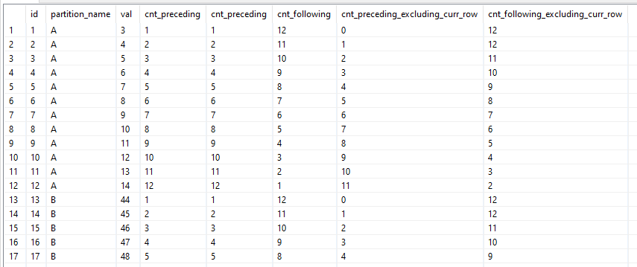
Window functions: count(*)
alter view master_class_2021_reporting.Window03 as
SELECT
Id,
"partition_name",
"val",
count(*) over(partition by "partition_name" order by id rows between unbounded preceding and current row) as cnt_preceding,
count(*) over(partition by "partition_name" order by id rows between unbounded preceding and current row) as cnt_preceding,
count(*) over(partition by "partition_name" order by id rows between current row and unbounded following) as cnt_following,
count(*) over(partition by "partition_name" order by id rows between unbounded preceding and 1 preceding) as cnt_preceding_excluding_curr_row,
count(*) over(partition by "partition_name" order by id rows between 1 preceding and unbounded following) as cnt_following_excluding_curr_row
FROM
"master_class_2021_reporting.Partition_Data"
order by id
;;

Slide 17
Window functions: rank vs dense_rank
https://docs.microsoft.com/en-us/sql/t-sql/functions/dense-rank-transact-sql?view=sql-server-ver15
SELECT p.FirstName, p.LastName, a.PostalCode
,ROW_NUMBER() OVER (ORDER BY a.PostalCode) AS "Row Number"
,RANK() OVER (ORDER BY a.PostalCode) AS Rank
,DENSE_RANK() OVER (ORDER BY a.PostalCode) AS "Dense Rank"
,NTILE(4) OVER (ORDER BY a.PostalCode) AS Quartile
FROM Sales.SalesPerson AS s
INNER JOIN Person.Person AS p
ON s.BusinessEntityID = p.BusinessEntityID
INNER JOIN Person.Address AS a
ON a.AddressID = p.BusinessEntityID
WHERE TerritoryID IS NOT NULL AND SalesYTD <> 0;
FirstName | LastName | PostalCode | Row Number | Rank | Dense Rank
Michael | Blythe | 98027 | 1 | 1 | 1
Linda | Mitchell | 98027 | 2 | 1 | 1
Jillian | Carson | 98027 | 3 | 1 | 1
Garrett | Vargas | 98027 | 4 | 1 | 1
Tsvi | Reiter | 98027 | 5 | 1 | 1
Pamela | Ansman-Wolfe | 98027 | 6 | 1 | 1
Shu | Ito | 98055 | 7 | 7 | 2
José | Saraiva | 98055 | 8 | 7 | 2
David | Campbell | 98055 | 9 | 7 | 2
Tete | Mensa-Annan | 98055 | 10 | 7 | 2
Lynn | Tsoflias | 98055 | 11 | 7 | 2
Rachel | Valdez | 98055 | 12 | 7 | 2
Jae | Pak | 98055 | 13 | 7 | 2
Ranjit | Varkey Chudukatil | 98055 | 14 | 7 | 2

Slide 18
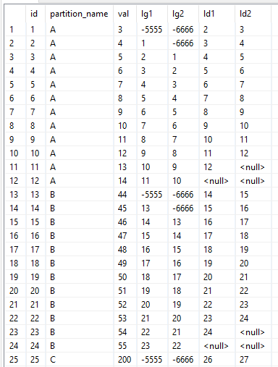
Window functions: lead and lag
alter view master_class_2021_reporting.Window04 as
SELECT
Id,
"partition_name",
"val",
lag(Id, 1, -5555) over(partition by "partition_name" order by id) as lg1,
lag(Id, 2, -6666) over(partition by "partition_name" order by id) as lg2,
lead(Id, 1) over(partition by "partition_name" order by id) as ld1,
lead(Id, 2) over(partition by "partition_name" order by id) as ld2
FROM
"master_class_2021_reporting.Partition_Data"
order by id
;;

Slide 19
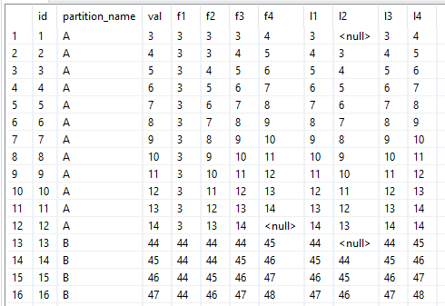
Window functions: first_value and last_value
alter view master_class_2021_reporting.Window05 as
SELECT
Id,
"partition_name",
"val",
first_value(val) over(partition by "partition_name" order by id) as f1,
first_value(val) over(partition by "partition_name" order by id
rows between 1 preceding AND UNBOUNDED FOLLOWING) as f2,
first_value(val) over(partition by "partition_name" order by id
rows between CURRENT ROW AND UNBOUNDED FOLLOWING) as f3,
first_value(val) over(partition by "partition_name" order by id
rows between 1 following AND UNBOUNDED FOLLOWING) as f4,
last_value(val) over(partition by "partition_name" order by id) as l1,
last_value(val) over(partition by "partition_name" order by id
rows between unbounded preceding AND 1 preceding) as l2,
last_value(val) over(partition by "partition_name" order by id
rows between unbounded preceding AND current row) as l3,
last_value(val) over(partition by "partition_name" order by id
rows between unbounded preceding AND 1 FOLLOWING) as l4
FROM
"master_class_2021_reporting.Partition_Data"
order by id
;;

Slide 20
Window functions: first_value and last_value
alter view master_class_2021_reporting.Window05 as
SELECT
Id,
"partition_name",
"val",
first_value(val) over(partition by "partition_name" order by id) as f1,
first_value(val) over(partition by "partition_name" order by id
rows between 1 preceding AND UNBOUNDED FOLLOWING) as f2,
first_value(val) over(partition by "partition_name" order by id
rows between CURRENT ROW AND UNBOUNDED FOLLOWING) as f3,
first_value(val) over(partition by "partition_name" order by id
rows between 1 following AND UNBOUNDED FOLLOWING) as f4,
last_value(val) over(partition by "partition_name" order by id) as l1,
last_value(val) over(partition by "partition_name" order by id
rows between unbounded preceding AND 1 preceding) as l2,
last_value(val) over(partition by "partition_name" order by id
rows between unbounded preceding AND current row) as l3,
last_value(val) over(partition by "partition_name" order by id
rows between unbounded preceding AND 1 FOLLOWING) as l4
FROM
"master_class_2021_reporting.Partition_Data"
order by id
;;

Slide 21
Window functions: first_value and last_value
alter view master_class_2021_reporting.Window05 as
SELECT
Id,
"partition_name",
"val",
first_value(val) over(partition by "partition_name" order by id) as f1,
first_value(val) over(partition by "partition_name" order by id
rows between 1 preceding AND UNBOUNDED FOLLOWING) as f2,
first_value(val) over(partition by "partition_name" order by id
rows between CURRENT ROW AND UNBOUNDED FOLLOWING) as f3,
first_value(val) over(partition by "partition_name" order by id
rows between 1 following AND UNBOUNDED FOLLOWING) as f4,
last_value(val) over(partition by "partition_name" order by id) as l1,
last_value(val) over(partition by "partition_name" order by id
rows between unbounded preceding AND 1 preceding) as l2,
last_value(val) over(partition by "partition_name" order by id
rows between unbounded preceding AND current row) as l3,
last_value(val) over(partition by "partition_name" order by id
rows between unbounded preceding AND 1 FOLLOWING) as l4
FROM
"master_class_2021_reporting.Partition_Data"
order by id
;;

Slide 22
Window functions: first_value and last_value
alter view master_class_2021_reporting.Window05 as
SELECT
Id,
"partition_name",
"val",
first_value(val) over(partition by "partition_name" order by id) as f1,
first_value(val) over(partition by "partition_name" order by id
rows between 1 preceding AND UNBOUNDED FOLLOWING) as f2,
first_value(val) over(partition by "partition_name" order by id
rows between CURRENT ROW AND UNBOUNDED FOLLOWING) as f3,
first_value(val) over(partition by "partition_name" order by id
rows between 1 following AND UNBOUNDED FOLLOWING) as f4,
last_value(val) over(partition by "partition_name" order by id) as l1,
last_value(val) over(partition by "partition_name" order by id
rows between unbounded preceding AND 1 preceding) as l2,
last_value(val) over(partition by "partition_name" order by id
rows between unbounded preceding AND current row) as l3,
last_value(val) over(partition by "partition_name" order by id
rows between unbounded preceding AND 1 FOLLOWING) as l4
FROM
"master_class_2021_reporting.Partition_Data"
order by id
;;

Slide 23
Window functions: first_value and last_value
alter view master_class_2021_reporting.Window05 as
SELECT
Id,
"partition_name",
"val",
first_value(val) over(partition by "partition_name" order by id) as f1,
first_value(val) over(partition by "partition_name" order by id
rows between 1 preceding AND UNBOUNDED FOLLOWING) as f2,
first_value(val) over(partition by "partition_name" order by id
rows between CURRENT ROW AND UNBOUNDED FOLLOWING) as f3,
first_value(val) over(partition by "partition_name" order by id
rows between 1 following AND UNBOUNDED FOLLOWING) as f4,
last_value(val) over(partition by "partition_name" order by id) as l1,
last_value(val) over(partition by "partition_name" order by id
rows between unbounded preceding AND 1 preceding) as l2,
last_value(val) over(partition by "partition_name" order by id
rows between unbounded preceding AND current row) as l3,
last_value(val) over(partition by "partition_name" order by id
rows between unbounded preceding AND 1 FOLLOWING) as l4
FROM
"master_class_2021_reporting.Partition_Data"
order by id
;;

Slide 24
Window functions: first_value and last_value
alter view master_class_2021_reporting.Window05 as
SELECT
Id,
"partition_name",
"val",
first_value(val) over(partition by "partition_name" order by id) as f1,
first_value(val) over(partition by "partition_name" order by id
rows between 1 preceding AND UNBOUNDED FOLLOWING) as f2,
first_value(val) over(partition by "partition_name" order by id
rows between CURRENT ROW AND UNBOUNDED FOLLOWING) as f3,
first_value(val) over(partition by "partition_name" order by id
rows between 1 following AND UNBOUNDED FOLLOWING) as f4,
last_value(val) over(partition by "partition_name" order by id) as l1,
last_value(val) over(partition by "partition_name" order by id
rows between unbounded preceding AND 1 preceding) as l2,
last_value(val) over(partition by "partition_name" order by id
rows between unbounded preceding AND current row) as l3,
last_value(val) over(partition by "partition_name" order by id
rows between unbounded preceding AND 1 FOLLOWING) as l4
FROM
"master_class_2021_reporting.Partition_Data"
order by id
;;

Slide 25
Window functions: first_value and last_value
alter view master_class_2021_reporting.Window05 as
SELECT
Id,
"partition_name",
"val",
first_value(val) over(partition by "partition_name" order by id) as f1,
first_value(val) over(partition by "partition_name" order by id
rows between 1 preceding AND UNBOUNDED FOLLOWING) as f2,
first_value(val) over(partition by "partition_name" order by id
rows between CURRENT ROW AND UNBOUNDED FOLLOWING) as f3,
first_value(val) over(partition by "partition_name" order by id
rows between 1 following AND UNBOUNDED FOLLOWING) as f4,
last_value(val) over(partition by "partition_name" order by id) as l1,
last_value(val) over(partition by "partition_name" order by id
rows between unbounded preceding AND 1 preceding) as l2,
last_value(val) over(partition by "partition_name" order by id
rows between unbounded preceding AND current row) as l3,
last_value(val) over(partition by "partition_name" order by id
rows between unbounded preceding AND 1 FOLLOWING) as l4
FROM
"master_class_2021_reporting.Partition_Data"
order by id
;;

Slide 26
Window functions: first_value and last_value
alter view master_class_2021_reporting.Window05 as
SELECT
Id,
"partition_name",
"val",
first_value(val) over(partition by "partition_name" order by id) as f1,
first_value(val) over(partition by "partition_name" order by id
rows between 1 preceding AND UNBOUNDED FOLLOWING) as f2,
first_value(val) over(partition by "partition_name" order by id
rows between CURRENT ROW AND UNBOUNDED FOLLOWING) as f3,
first_value(val) over(partition by "partition_name" order by id
rows between 1 following AND UNBOUNDED FOLLOWING) as f4,
last_value(val) over(partition by "partition_name" order by id) as l1,
last_value(val) over(partition by "partition_name" order by id
rows between unbounded preceding AND 1 preceding) as l2,
last_value(val) over(partition by "partition_name" order by id
rows between unbounded preceding AND current row) as l3,
last_value(val) over(partition by "partition_name" order by id
rows between unbounded preceding AND 1 FOLLOWING) as l4
FROM
"master_class_2021_reporting.Partition_Data"
order by id
;;

Slide 27
Putting it together: YTD, rolling avg, period over period

Slide 28
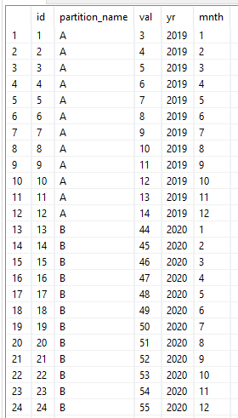
YTD, rolling avg, period over period
select * from master_class_2021_reporting.Partition_Data;;

Slide 29
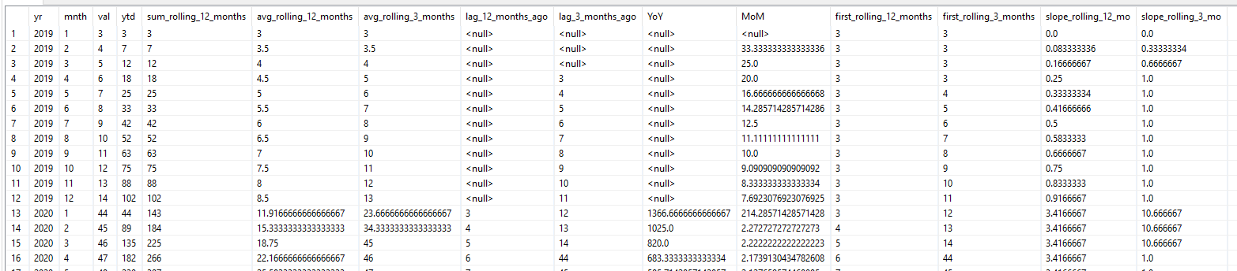
YTD, rolling avg, period over period
create view master_class_2021_reporting.Window06 as
with cte as (
SELECT
yr, mnth,
val,
sum(val) over(partition by yr order by yr, mnth) as ytd,
sum(val) over(order by yr, mnth rows between 11 preceding and current row) as sum_rolling_12_months,
avg(val) over(order by yr, mnth rows between 11 preceding and current row) as avg_rolling_12_months,
avg(val) over(order by yr, mnth rows between 2 preceding and current row) as avg_rolling_3_months,
lag(val, 12) over(order by yr, mnth) as lag_12_months_ago,
lag(val, 3) over(order by yr, mnth) as lag_3_months_ago,
case
when (lag(val, 12) over(order by yr, mnth)) is null then cast(null as float)
else cast(100.0 as float) * (val - (lag(val, 12) over(order by yr, mnth)))
/ (lag(val, 12) over(order by yr, mnth))
end as YoY,
case
when (lag(val, 1) over(order by yr, mnth)) is null then cast(null as float)
else cast(100.0 as float) * (val - (lag(val, 1) over(order by yr, mnth)))
/ (lag(val, 1) over(order by yr, mnth))
end as MoM,
first_value(val) over(order by yr, mnth
rows between 12 preceding AND current row) as first_rolling_12_months,
first_value(val) over(order by yr, mnth
rows between 3 preceding AND current row) as first_rolling_3_months
FROM
"master_class_2021_reporting.Partition_Data"
)
select
cte.*,
cast(val - ifnull(lag_12_months_ago, first_rolling_12_months) as float) / 12.0 as slope_rolling_12_mo,
cast(val - ifnull(lag_3_months_ago, first_rolling_3_months) as float) / 3.0 as slope_rolling_3_mo
from
cte
order by yr, mnth
;;

Slide 30
YTD, rolling avg, period over period
create view master_class_2021_reporting.Window06 as
with cte as (
SELECT
yr, mnth,
val,
sum(val) over(partition by yr order by yr, mnth) as ytd,
sum(val) over(order by yr, mnth rows between 11 preceding and current row) as sum_rolling_12_months,
avg(val) over(order by yr, mnth rows between 11 preceding and current row) as avg_rolling_12_months,
avg(val) over(order by yr, mnth rows between 2 preceding and current row) as avg_rolling_3_months,
lag(val, 12) over(order by yr, mnth) as lag_12_months_ago,
lag(val, 3) over(order by yr, mnth) as lag_3_months_ago,
case
when (lag(val, 12) over(order by yr, mnth)) is null then cast(null as float)
else cast(100.0 as float) * (val - (lag(val, 12) over(order by yr, mnth)))
/ (lag(val, 12) over(order by yr, mnth))
end as YoY,
case
when (lag(val, 1) over(order by yr, mnth)) is null then cast(null as float)
else cast(100.0 as float) * (val - (lag(val, 1) over(order by yr, mnth)))
/ (lag(val, 1) over(order by yr, mnth))
end as MoM,
first_value(val) over(order by yr, mnth
rows between 12 preceding AND current row) as first_rolling_12_months,
first_value(val) over(order by yr, mnth
rows between 3 preceding AND current row) as first_rolling_3_months
FROM
"master_class_2021_reporting.Partition_Data"
)
select
cte.*,
cast(val - ifnull(lag_12_months_ago, first_rolling_12_months) as float) / 12.0 as slope_rolling_12_mo,
cast(val - ifnull(lag_3_months_ago, first_rolling_3_months) as float) / 3.0 as slope_rolling_3_mo
from
cte
order by yr, mnth
;;

Slide 31
YTD, rolling avg, period over period
create view master_class_2021_reporting.Window06 as
with cte as (
SELECT
yr, mnth,
val,
sum(val) over(partition by yr order by yr, mnth) as ytd,
sum(val) over(order by yr, mnth rows between 11 preceding and current row) as sum_rolling_12_months,
avg(val) over(order by yr, mnth rows between 11 preceding and current row) as avg_rolling_12_months,
avg(val) over(order by yr, mnth rows between 2 preceding and current row) as avg_rolling_3_months,
lag(val, 12) over(order by yr, mnth) as lag_12_months_ago,
lag(val, 3) over(order by yr, mnth) as lag_3_months_ago,
case
when (lag(val, 12) over(order by yr, mnth)) is null then cast(null as float)
else cast(100.0 as float) * (val - (lag(val, 12) over(order by yr, mnth)))
/ (lag(val, 12) over(order by yr, mnth))
end as YoY,
case
when (lag(val, 1) over(order by yr, mnth)) is null then cast(null as float)
else cast(100.0 as float) * (val - (lag(val, 1) over(order by yr, mnth)))
/ (lag(val, 1) over(order by yr, mnth))
end as MoM,
first_value(val) over(order by yr, mnth
rows between 12 preceding AND current row) as first_rolling_12_months,
first_value(val) over(order by yr, mnth
rows between 3 preceding AND current row) as first_rolling_3_months
FROM
"master_class_2021_reporting.Partition_Data"
)
select
cte.*,
cast(val - ifnull(lag_12_months_ago, first_rolling_12_months) as float) / 12.0 as slope_rolling_12_mo,
cast(val - ifnull(lag_3_months_ago, first_rolling_3_months) as float) / 3.0 as slope_rolling_3_mo
from
cte
order by yr, mnth
;;

Slide 32
YTD, rolling avg, period over period
create view master_class_2021_reporting.Window06 as
with cte as (
SELECT
yr, mnth,
val,
sum(val) over(partition by yr order by yr, mnth) as ytd,
sum(val) over(order by yr, mnth rows between 11 preceding and current row) as sum_rolling_12_months,
avg(val) over(order by yr, mnth rows between 11 preceding and current row) as avg_rolling_12_months,
avg(val) over(order by yr, mnth rows between 2 preceding and current row) as avg_rolling_3_months,
lag(val, 12) over(order by yr, mnth) as lag_12_months_ago,
lag(val, 3) over(order by yr, mnth) as lag_3_months_ago,
case
when (lag(val, 12) over(order by yr, mnth)) is null then cast(null as float)
else cast(100.0 as float) * (val - (lag(val, 12) over(order by yr, mnth)))
/ (lag(val, 12) over(order by yr, mnth))
end as YoY,
case
when (lag(val, 1) over(order by yr, mnth)) is null then cast(null as float)
else cast(100.0 as float) * (val - (lag(val, 1) over(order by yr, mnth)))
/ (lag(val, 1) over(order by yr, mnth))
end as MoM,
first_value(val) over(order by yr, mnth
rows between 12 preceding AND current row) as first_rolling_12_months,
first_value(val) over(order by yr, mnth
rows between 3 preceding AND current row) as first_rolling_3_months
FROM
"master_class_2021_reporting.Partition_Data"
)
select
cte.*,
cast(val - ifnull(lag_12_months_ago, first_rolling_12_months) as float) / 12.0 as slope_rolling_12_mo,
cast(val - ifnull(lag_3_months_ago, first_rolling_3_months) as float) / 3.0 as slope_rolling_3_mo
from
cte
order by yr, mnth
;;

Slide 33
YTD, rolling avg, period over period
SELECT * FROM "master_class_2021_reporting.Window06";;
yr | mnth | val | ytd | sum_rolling_12_months | avg_rolling_12_months | avg_rolling_3_months | lag_12_months_ago | lag_3_months_ago | YoY | MoM | first_rolling_12_months | first_rolling_3_months | slope_rolling_12_mo | slope_rolling_3_mo
2019 | 1 | 3 | 3 | 3 | 3 | 3 |  |  |  |  | 3 | 3 | - | -
2019 | 2 | 4 | 7 | 7 | 3.5 | 3.5 |  |  |  | 33.33333 | 3 | 3 | 0.0833 | 0.3333
2019 | 3 | 5 | 12 | 12 | 4 | 4 |  |  |  | 25 | 3 | 3 | 0.1667 | 0.6667
2019 | 4 | 6 | 18 | 18 | 4.5 | 5 |  | 3 |  | 20 | 3 | 3 | 0.2500 | 1.0000
2019 | 5 | 7 | 25 | 25 | 5 | 6 |  | 4 |  | 16.66667 | 3 | 4 | 0.3333 | 1.0000
2019 | 6 | 8 | 33 | 33 | 5.5 | 7 |  | 5 |  | 14.28571 | 3 | 5 | 0.4167 | 1.0000
2019 | 7 | 9 | 42 | 42 | 6 | 8 |  | 6 |  | 12.5 | 3 | 6 | 0.5000 | 1.0000
2019 | 8 | 10 | 52 | 52 | 6.5 | 9 |  | 7 |  | 11.11111 | 3 | 7 | 0.5833 | 1.0000
2019 | 9 | 11 | 63 | 63 | 7 | 10 |  | 8 |  | 10 | 3 | 8 | 0.6667 | 1.0000
2019 | 10 | 12 | 75 | 75 | 7.5 | 11 |  | 9 |  | 9.090909 | 3 | 9 | 0.7500 | 1.0000
2019 | 11 | 13 | 88 | 88 | 8 | 12 |  | 10 |  | 8.333333 | 3 | 10 | 0.8333 | 1.0000
2019 | 12 | 14 | 102 | 102 | 8.5 | 13 |  | 11 |  | 7.692308 | 3 | 11 | 0.9167 | 1.0000
2020 | 1 | 44 | 44 | 143 | 11.91667 | 23.66667 | 3 | 12 | 1366.667 | 214.2857 | 3 | 12 | 3.4167 | 10.6667
2020 | 2 | 45 | 89 | 184 | 15.33333 | 34.33333 | 4 | 13 | 1025 | 2.272727 | 4 | 13 | 3.4167 | 10.6667
2020 | 3 | 46 | 135 | 225 | 18.75 | 45 | 5 | 14 | 820 | 2.222222 | 5 | 14 | 3.4167 | 10.6667
2020 | 4 | 47 | 182 | 266 | 22.16667 | 46 | 6 | 44 | 683.3333 | 2.173913 | 6 | 44 | 3.4167 | 1.0000
2020 | 5 | 48 | 230 | 307 | 25.58333 | 47 | 7 | 45 | 585.7143 | 2.12766 | 7 | 45 | 3.4167 | 1.0000
2020 | 6 | 49 | 279 | 348 | 29 | 48 | 8 | 46 | 512.5 | 2.083333 | 8 | 46 | 3.4167 | 1.0000
2020 | 7 | 50 | 329 | 389 | 32.41667 | 49 | 9 | 47 | 455.5556 | 2.040816 | 9 | 47 | 3.4167 | 1.0000
2020 | 8 | 51 | 380 | 430 | 35.83333 | 50 | 10 | 48 | 410 | 2 | 10 | 48 | 3.4167 | 1.0000
2020 | 9 | 52 | 432 | 471 | 39.25 | 51 | 11 | 49 | 372.7273 | 1.960784 | 11 | 49 | 3.4167 | 1.0000
2020 | 10 | 53 | 485 | 512 | 42.66667 | 52 | 12 | 50 | 341.6667 | 1.923077 | 12 | 50 | 3.4167 | 1.0000
2020 | 11 | 54 | 539 | 553 | 46.08333 | 53 | 13 | 51 | 315.3846 | 1.886792 | 13 | 51 | 3.4167 | 1.0000
2020 | 12 | 55 | 594 | 594 | 49.5 | 54 | 14 | 52 | 292.8571 | 1.851852 | 14 | 52 | 3.4167 | 1.0000
2021 | 1 | 200 | 200 | 750 | 62.5 | 103 | 44 | 53 | 354.5455 | 263.6364 | 44 | 53 | 13.0000 | 49.0000
2021 | 2 | 201 | 401 | 906 | 75.5 | 152 | 45 | 54 | 346.6667 | 0.5 | 45 | 54 | 13.0000 | 49.0000
2021 | 3 | 202 | 603 | 1062 | 88.5 | 201 | 46 | 55 | 339.1304 | 0.497512 | 46 | 55 | 13.0000 | 49.0000
2021 | 4 | 203 | 806 | 1218 | 101.5 | 202 | 47 | 200 | 331.9149 | 0.49505 | 47 | 200 | 13.0000 | 1.0000
2021 | 5 | 204 | 1010 | 1374 | 114.5 | 203 | 48 | 201 | 325 | 0.492611 | 48 | 201 | 13.0000 | 1.0000
2021 | 6 | 205 | 1215 | 1530 | 127.5 | 204 | 49 | 202 | 318.3673 | 0.490196 | 49 | 202 | 13.0000 | 1.0000
2021 | 7 | 206 | 1421 | 1686 | 140.5 | 205 | 50 | 203 | 312 | 0.487805 | 50 | 203 | 13.0000 | 1.0000
2021 | 8 | 207 | 1628 | 1842 | 153.5 | 206 | 51 | 204 | 305.8824 | 0.485437 | 51 | 204 | 13.0000 | 1.0000
2021 | 9 | 208 | 1836 | 1998 | 166.5 | 207 | 52 | 205 | 300 | 0.483092 | 52 | 205 | 13.0000 | 1.0000
2021 | 10 | 209 | 2045 | 2154 | 179.5 | 208 | 53 | 206 | 294.3396 | 0.480769 | 53 | 206 | 13.0000 | 1.0000
2021 | 11 | 210 | 2255 | 2310 | 192.5 | 209 | 54 | 207 | 288.8889 | 0.478469 | 54 | 207 | 13.0000 | 1.0000
2021 | 12 | 211 | 2466 | 2466 | 205.5 | 210 | 55 | 208 | 283.6364 | 0.47619 | 55 | 208 | 13.0000 | 1.0000

Slide 34
Pivoting data

Slide 35
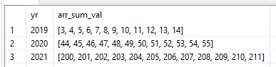
Pivoting data: method 1
with cte as (
SELECT yr, mnth, sum(val) as sum_val
FROM "master_class_2021_reporting.Partition_Data"
group by yr, mnth
order by yr, mnth
)
select
yr
,array_agg (sum_val order by yr, mnth) as arr_sum_val
from
cte
group by
yr
;;

Slide 36
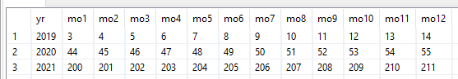
Pivoting data: method 1
create view master_class_2021_reporting.pivot_01 as
with cte as (
SELECT yr, mnth, sum(val) as sum_val
FROM "master_class_2021_reporting.Partition_Data"
group by yr, mnth
order by yr, mnth
), cte2 as (
select
yr
,array_agg (sum_val order by yr, mnth) as arr_sum_val
from
cte
group by
yr
)
select
yr
,array_get(arr_sum_val, 1) as "mo1"
,array_get(arr_sum_val, 2) as "mo2"
,array_get(arr_sum_val, 3) as "mo3"
,array_get(arr_sum_val, 4) as "mo4"
,array_get(arr_sum_val, 5) as "mo5"
,array_get(arr_sum_val, 6) as "mo6"
,array_get(arr_sum_val, 7) as "mo7"
,array_get(arr_sum_val, 8) as "mo8"
,array_get(arr_sum_val, 9) as "mo9"
,array_get(arr_sum_val, 10) as "mo10"
,array_get(arr_sum_val, 11) as "mo11"
,array_get(arr_sum_val, 12) as "mo12"
from
cte2
;;

Slide 37
Pivoting data: method 2
create view master_class_2021_reporting.pivot_02 as
with cte as (
SELECT yr, mnth, sum(val) as sum_val
FROM "master_class_2021_reporting.Partition_Data"
group by yr, mnth
order by yr, mnth
)
SELECT
p.yr,
mo1.sum_val as mo1,
mo2.sum_val as mo2,
mo3.sum_val as mo3,
mo4.sum_val as mo4,
mo5.sum_val as mo5,
mo6.sum_val as mo6,
mo7.sum_val as mo7,
mo8.sum_val as mo8,
mo9.sum_val as mo9,
mo10.sum_val as mo10,
mo11.sum_val as mo11,
mo12.sum_val as mo12
FROM
(SELECT yr FROM "master_class_2021_reporting.Partition_Data" group by yr) p
join cte mo1 on p.yr = mo1.yr and mo1.mnth = 1
join cte mo2 on p.yr = mo2.yr and mo2.mnth = 2
join cte mo3 on p.yr = mo3.yr and mo3.mnth = 3
join cte mo4 on p.yr = mo4.yr and mo4.mnth = 4
join cte mo5 on p.yr = mo5.yr and mo5.mnth = 5
join cte mo6 on p.yr = mo6.yr and mo6.mnth = 6
join cte mo7 on p.yr = mo7.yr and mo7.mnth = 7
join cte mo8 on p.yr = mo8.yr and mo8.mnth = 8
join cte mo9 on p.yr = mo9.yr and mo9.mnth = 9
join cte mo10 on p.yr = mo10.yr and mo10.mnth = 10
join cte mo11 on p.yr = mo11.yr and mo11.mnth = 11
join cte mo12 on p.yr = mo12.yr and mo12.mnth = 12
;;

Slide 38
Unpivoting data

Slide 39
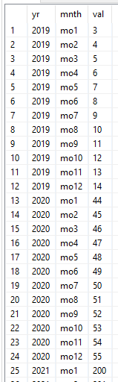
Unpivoting data
create view master_class_2021_reporting.unpivot as
SELECT
yr, mnth, val
FROM
(
SELECT yr, mo1, mo2, mo3, mo4, mo5, mo6, mo7, mo8, mo9, mo10, mo11, mo12
FROM master_class_2021_reporting.pivot_01
) p
UNPIVOT (
val FOR mnth IN (mo1, mo2, mo3, mo4, mo5, mo6, mo7, mo8, mo9, mo10, mo11, mo12)
) AS unpvt
;;

Slide 40
Any feedback / questions?

Slide 41
Thank you!
Please feel free to contact us at:
info@datavirtuality.com
or
visit us at:
datavirtuality.com

